Slide 1

CITY NAVIGATION AND EMERGENCY
ROUTE PLANNING
TOOL
Team 3 - Algo Wizards
CPSC 535: Advanced Algorithms
(Fall 2023)
Project 2

Slide 2
TEAM MEMBERS & ROLES
Algorithm Implementation - Tejashwa Tiwari and Anshika Khandelwal
Simulation of Blockages - James kim and Rishitha Bathini
User Interface (UI) and Visualization - Anthony Martinez and Pravallika Bahadur
Data Collection - Param Venkat Vivek Kesireddy
Project Coordinator - Pravallika Bahadur

Slide 3
INTRODUCTION
•This project aims to provide a practical and user-friendly tool for emergency route planning by calculating the shortest routes between key landmarks using the Floyd-Warshall algorithm.
•Why Floyd-Warshall?

Slide 4
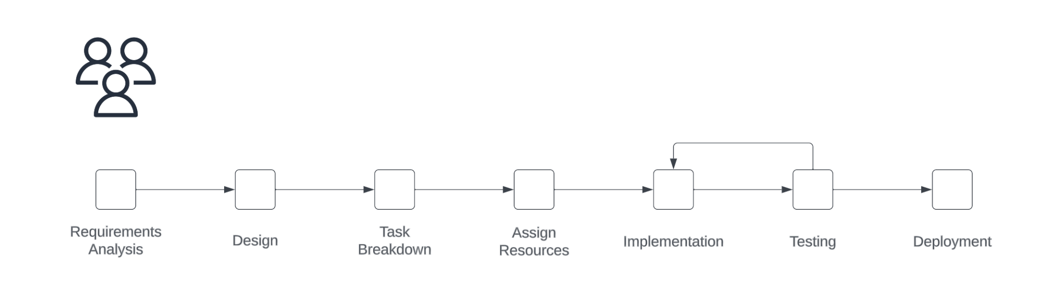
OBJECTIVE & OVERVIEW
In times of crisis, obstructed roads create obstacles for emergency responders. Creating an essential city navigation tool becomes imperative. This tool must utilize the Floyd-Warshall algorithm to calculate the shortest paths between landmarks, factoring in alternative routes

Slide 5
Target Users & Use Cases
Target Users:
Emergency Responders
Emergency Management Agencies
Urban Planners
City Officials
Citizens
Use Cases:
Disaster Response
Medical Emergencies
Fire Incidents
Law Enforcement
Evacuation Planning
Traffic Management
Community Awareness

Slide 6
Tools Used
Front End:
React.js - Front end js framework
Material UI - Styling and Components
Leaflet (React) - Map Visualization
Vis.js - Graph Visualization

Slide 7
Tools Used
Back End:
Node.js - Server framework and Floyd-Warshall implementation
Express.js - API routes
Concurrently - Runs front and backend concurrently

Slide 8
DATA COLLECTION
Overpass Turbo: Streamlining OSM Data Analysis
Tool that uses the Overpass API to interactively query and analyze OpenStreetMap (OSM) data on a map, complete with an integrated query wizard for simplicity.
Data Ingestion Framework
Generates two CSV files - Labeled nodes with road features
- Edges with street information and weightage based on distance
Data Filtering by rigorous filtering mechanism

Slide 9
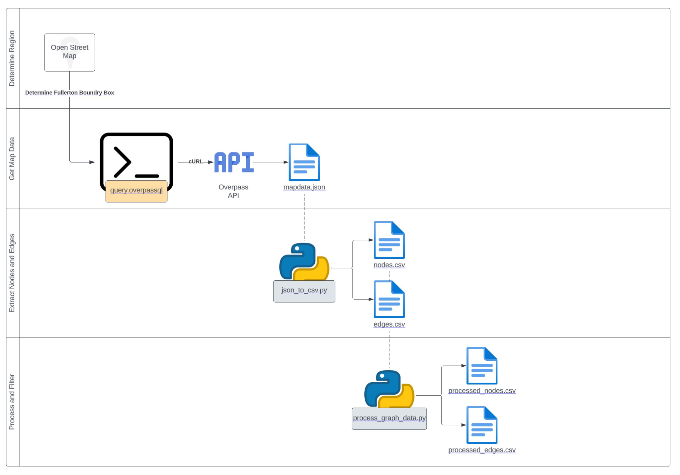

Slide 10
BLOCKAGE STRATEGY
Keep the backend stateless.
If api is called to block random edges and calculate the shortest path, this action shouldn’t affect future api calls. That way, we can make sure that users don’t experience a side effect from other users.
Make the apis more flexible Instead of creating different apis for getting a shortest path with or without blocked edges, we just made the API more flexible with variables. When a client makes a request with a variable for blocked paths or edges, the backend takes care of it accordingly.

Slide 11
USER INTERFACE
Opens up a http server that handles requests for location data and route calculations by data from CSV files, provides endpoint handlers for location and route requests, and listens on a specified port and hostname.

Slide 12
Algorithm
User clicks on an arbitrary point on the map. This is starting node
User clicks on another arbitrary point on the map. This is ending node
Express.js endpoint determines the closest nodes to the user selected
Floyd-Warshall
Return intermediate nodes
Plot and draw a polyline between each node
Plot a graph using just the nodes and edges returned

Slide 13
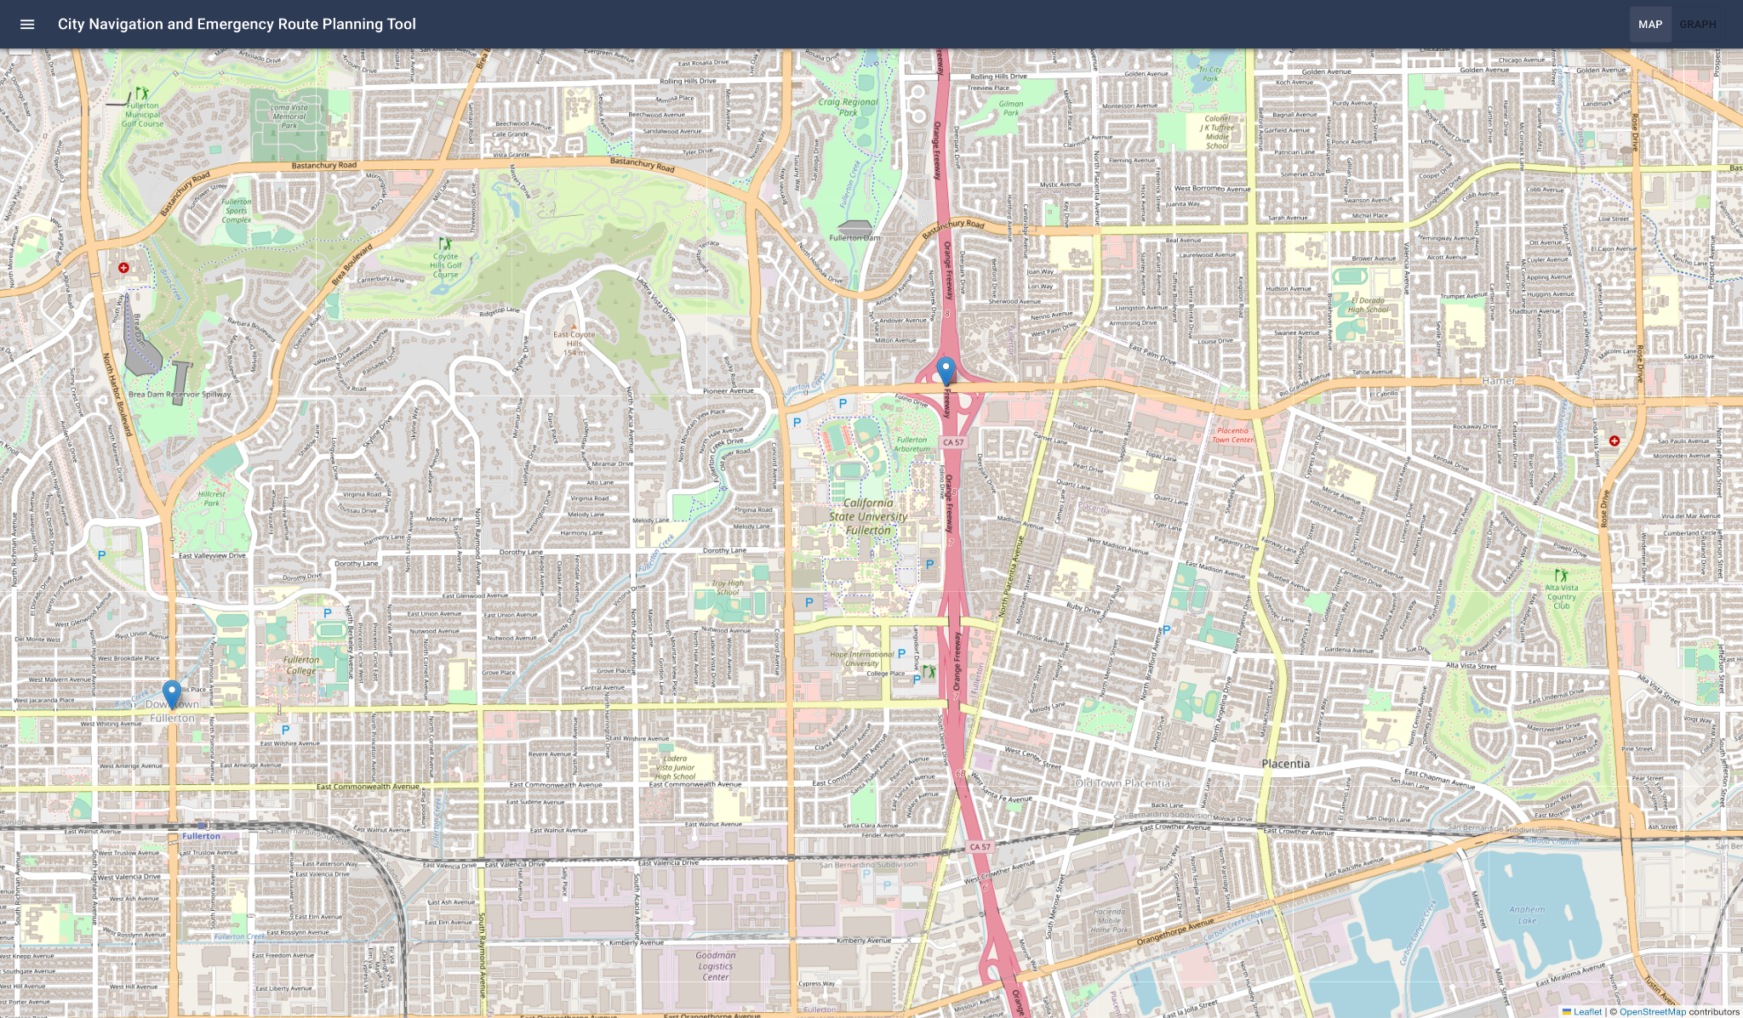
Directions Using Shortest Path

Slide 14
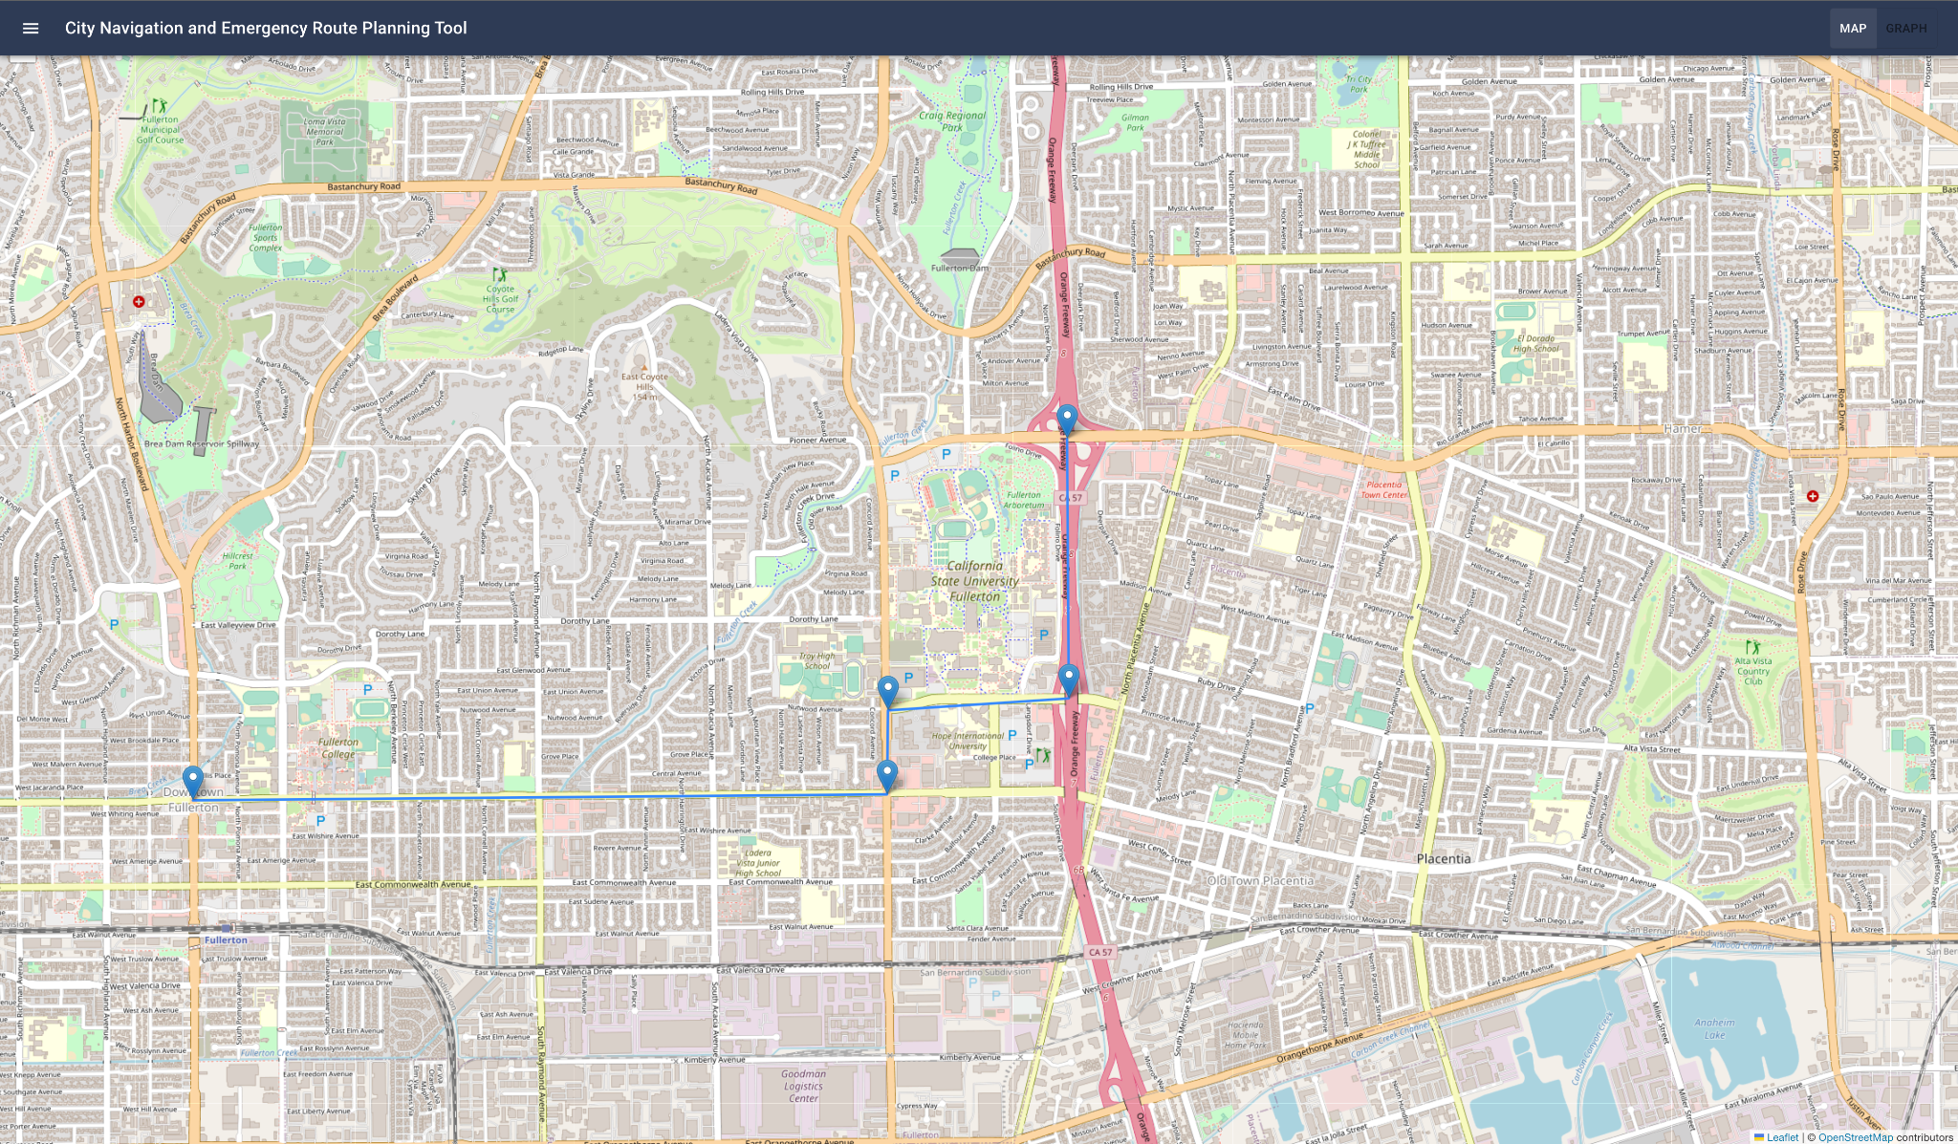
Directions Using Shortest Path

Slide 15
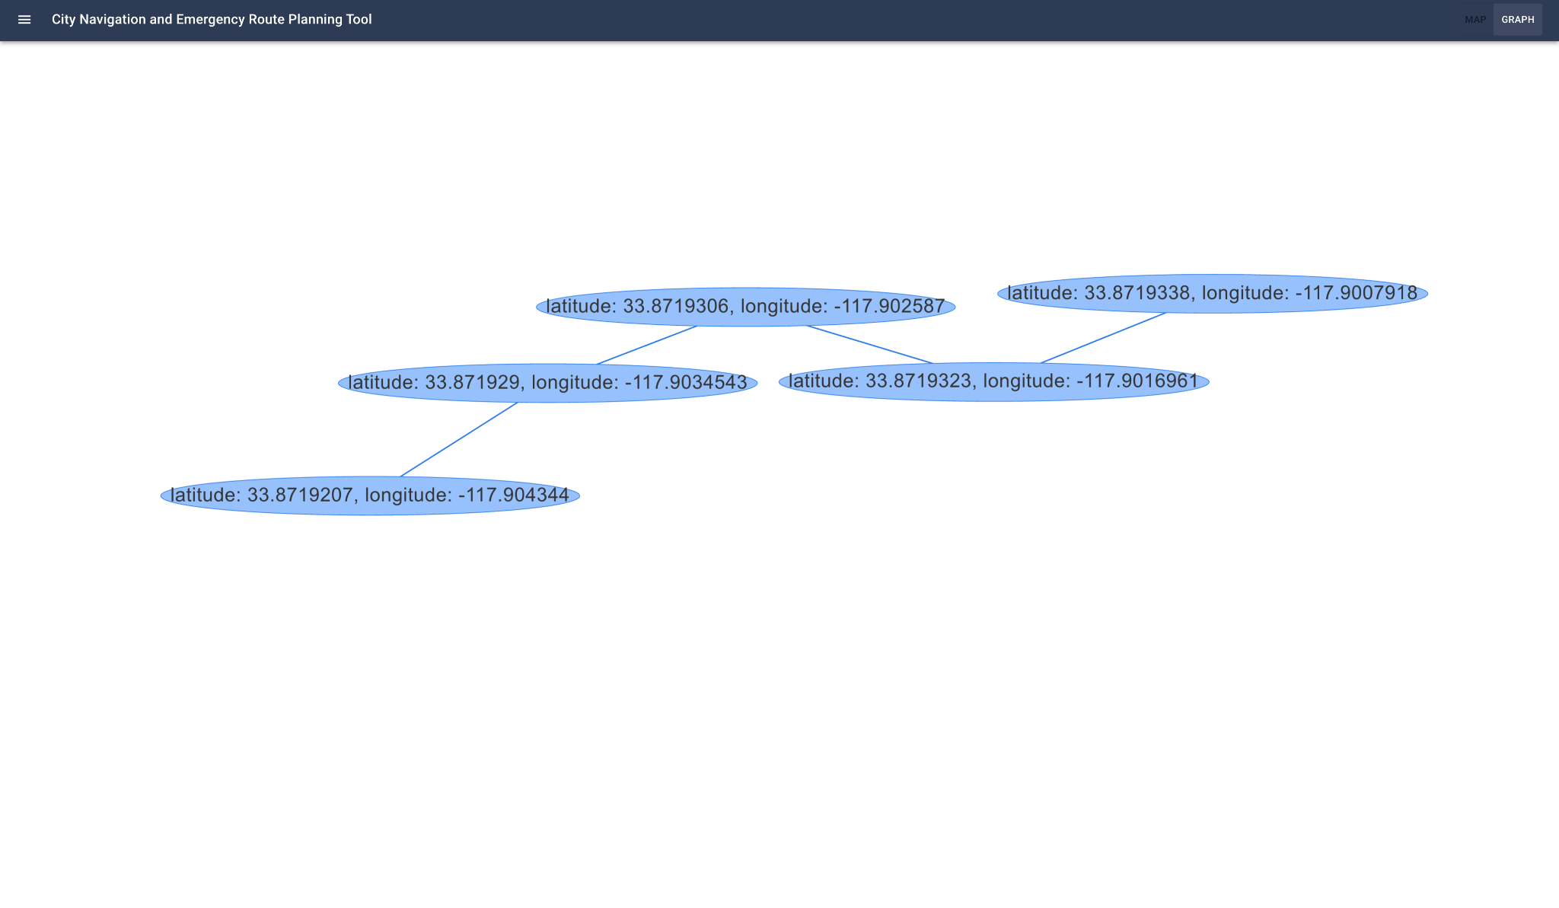
VISUALIZING THE SHORT DISTANCE

Slide 16
CHALLENGES FACED
Data Collection
Problems with UI while working with graph.

Slide 17
Testing
Verified that every UI component—including input validation and error handling—is operating as expected.
To guarantee compatibility, tested our tool across a range of web browsers (such as Chrome, Firefox, and Safari) and platforms (such as desktop, tablet, and mobile).
Tested how the server interacts with the front-end templates.
Have real users interact with our tool and took feedback.
Made sure that our tool operates well and doesn't crash when presented with strange data, tested it using extreme or unexpected inputs.
Ensure that error messages are properly shown, and assist users in understanding what went wrong and how to fix it.

Slide 18
Conclusion
In summary, integrating the Floyd-Warshall algorithm into urban navigation tools transforms emergency response. By calculating the best routes, adjusting to dynamic situations, and incorporating live data, it guarantees rapid and efficient actions, preserving lives during emergencies. Its flexibility and effectiveness are crucial for developing robust and responsive urban emergency systems.

Slide 19
THANK YOU
Any Questions?
Group 3 - Algo Wizards
Anthony Martinez | James kim
Anshika Khandelwal | Pravallika Bahadur
Tejashwa Tiwari | Rishitha Bathini
Param Venkat Vivek Kesireddy

